Slide 1
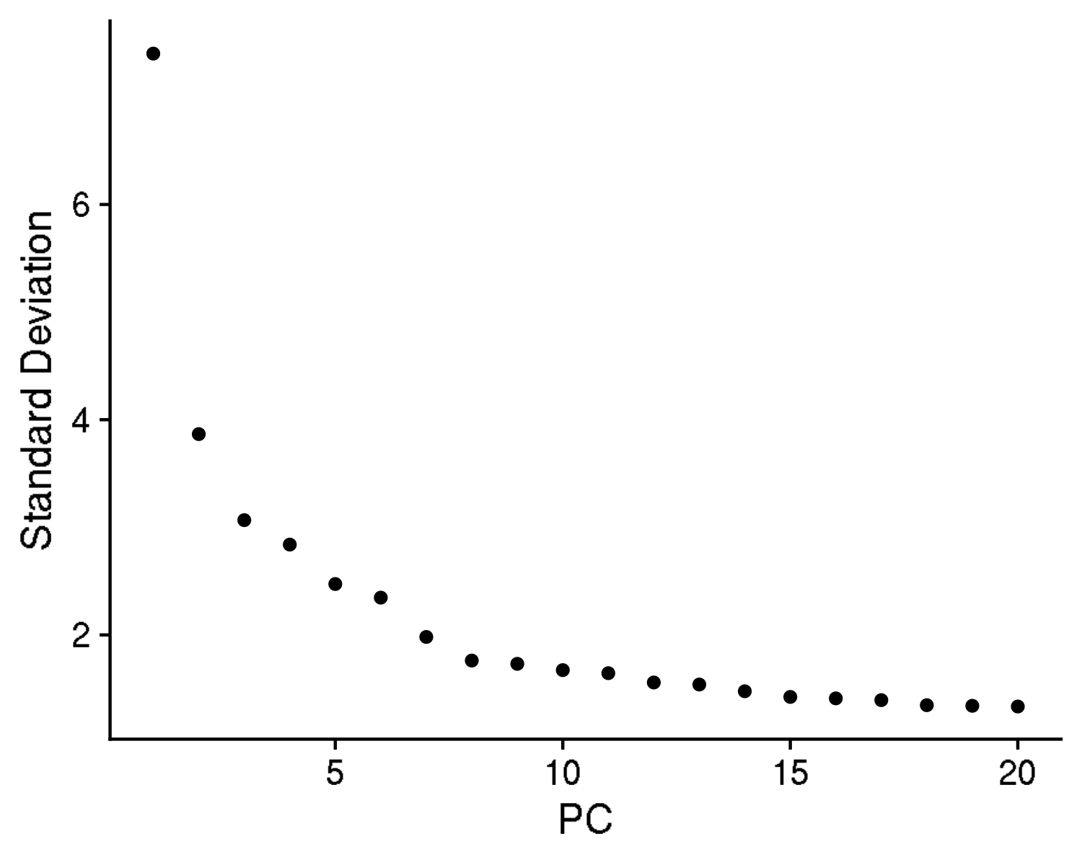
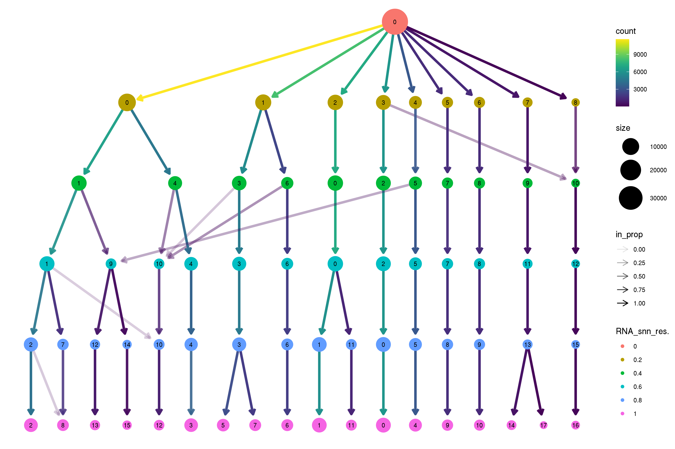
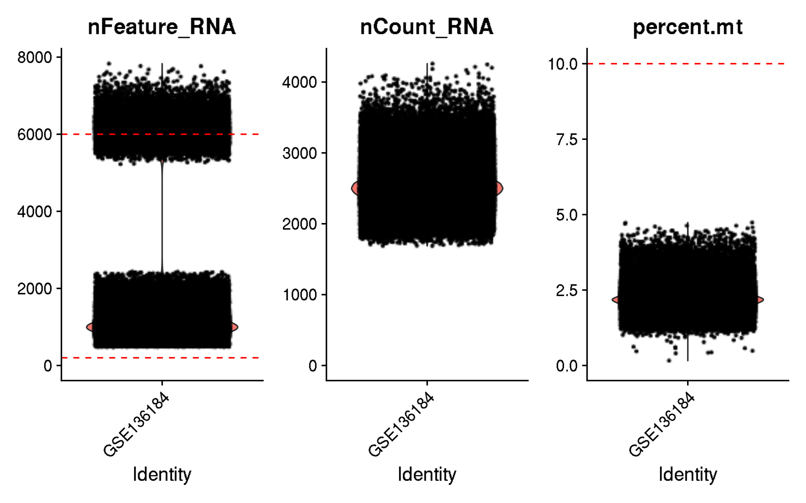
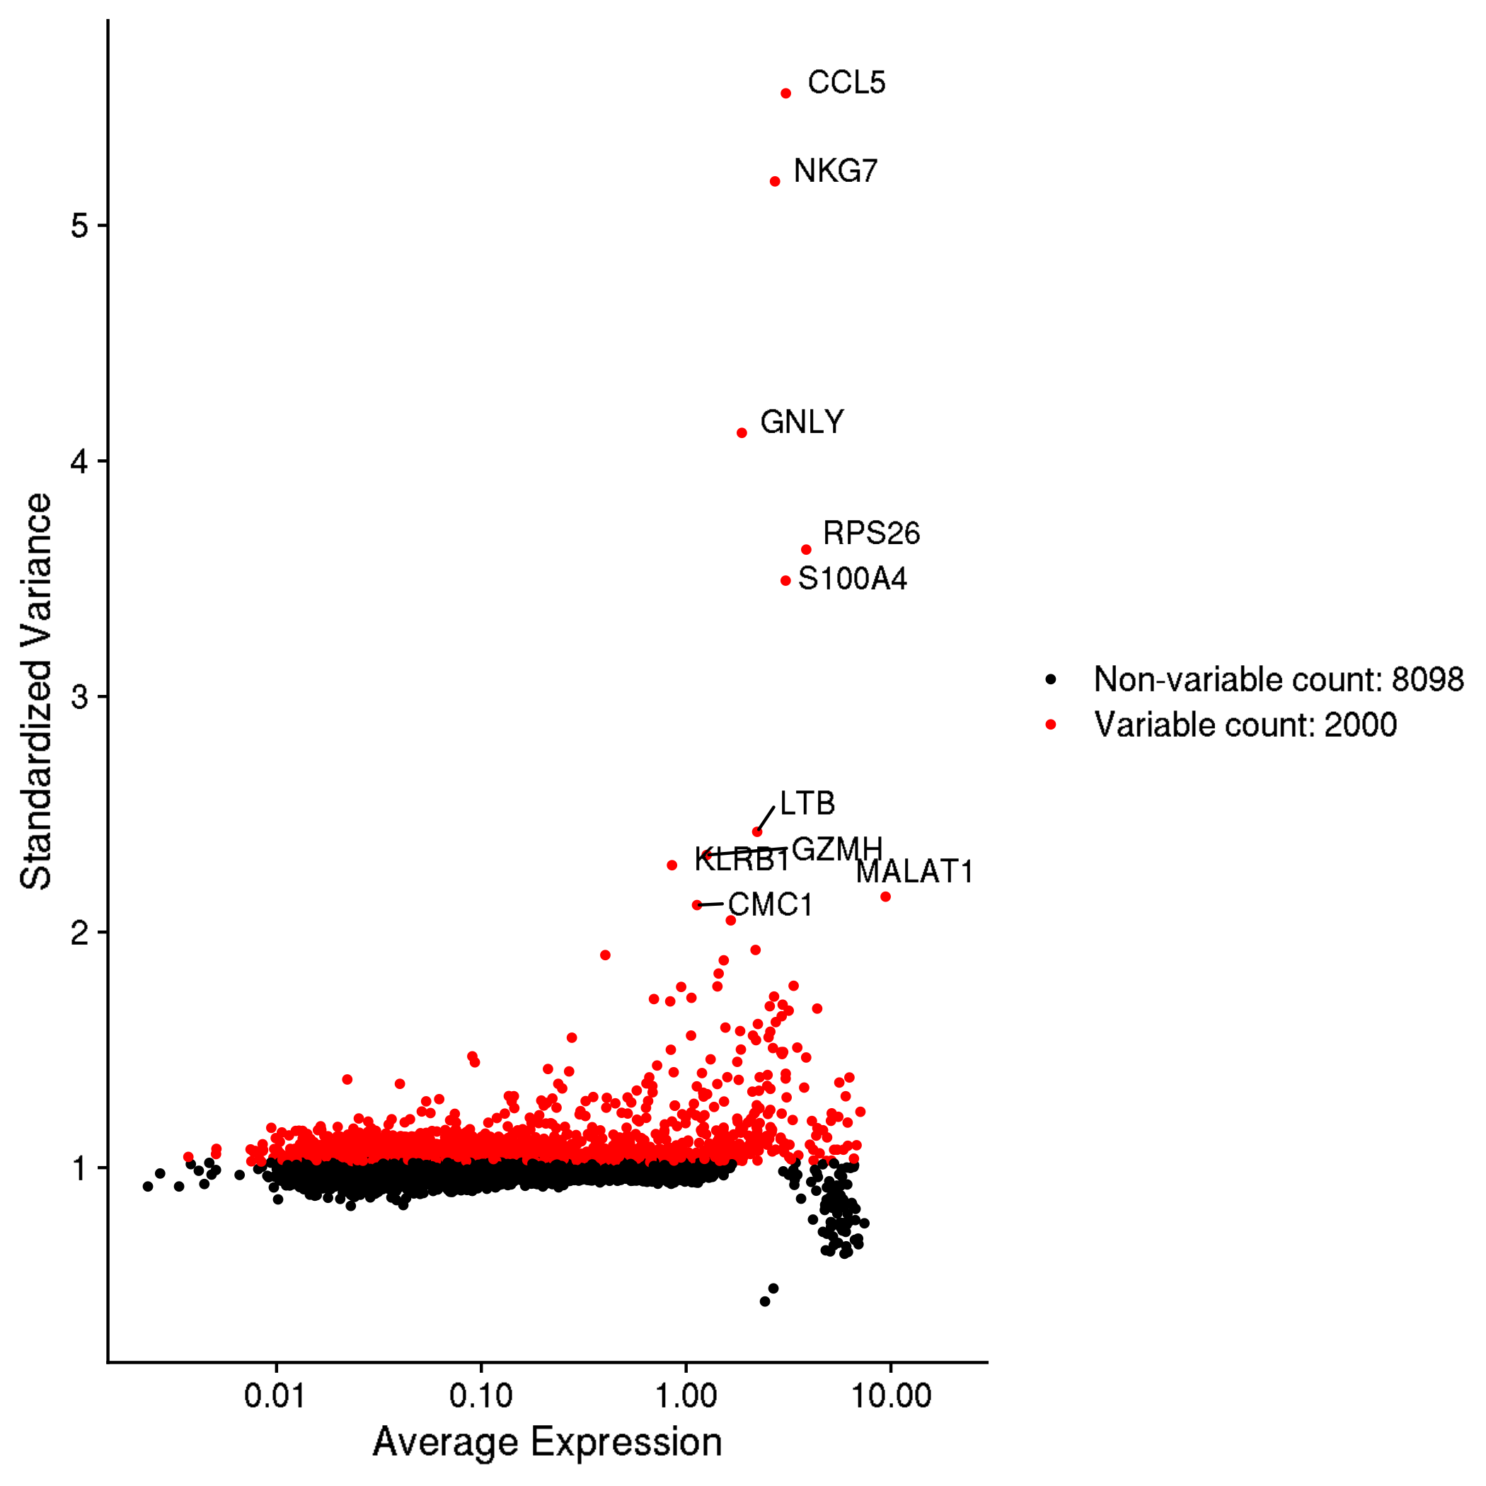
GSE136184: CD8+ T cells across 9 decades of life
Inspection and quality control

Slide 2
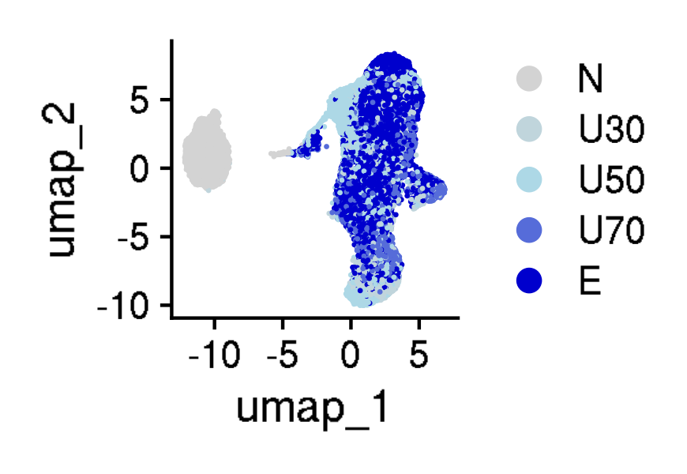
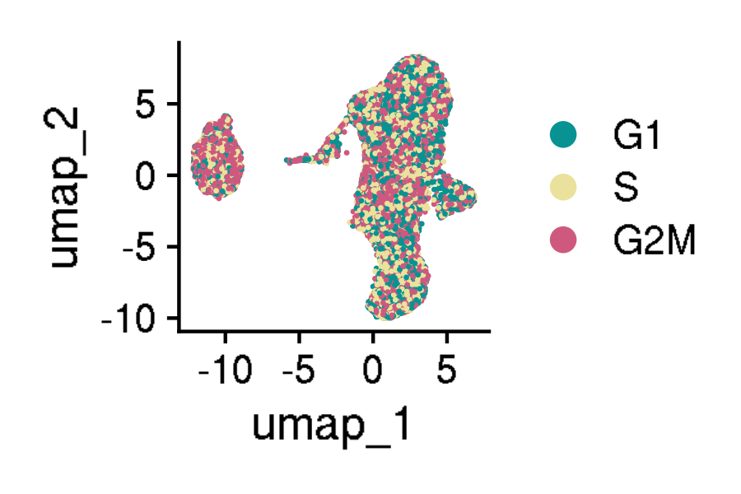
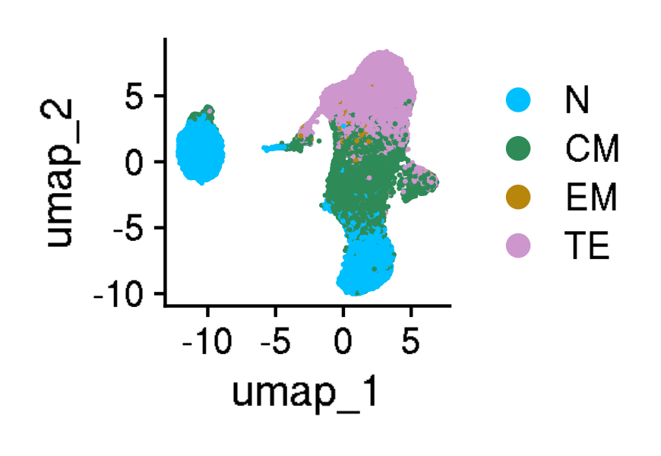
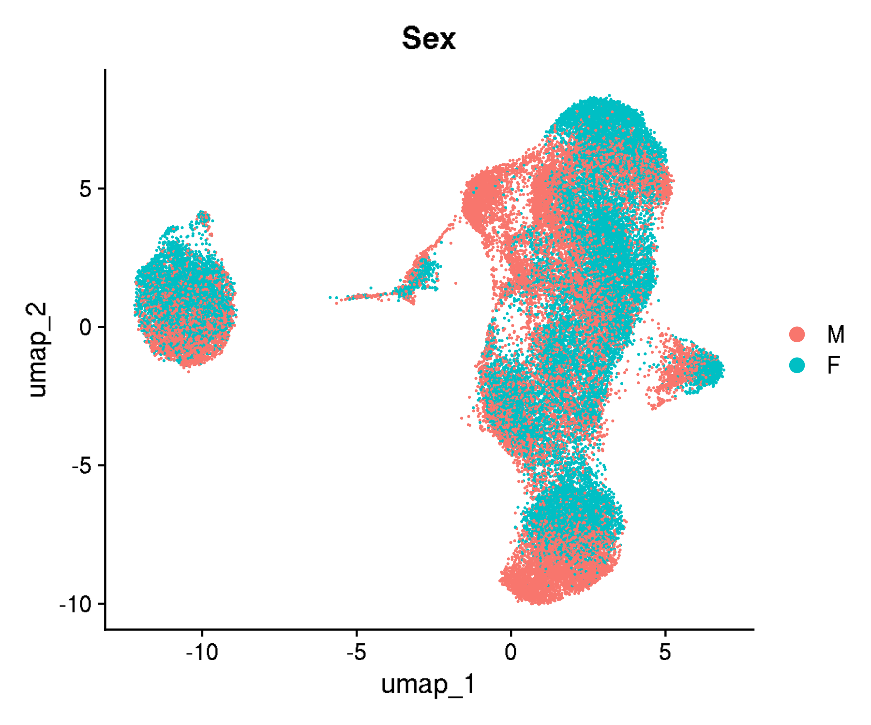
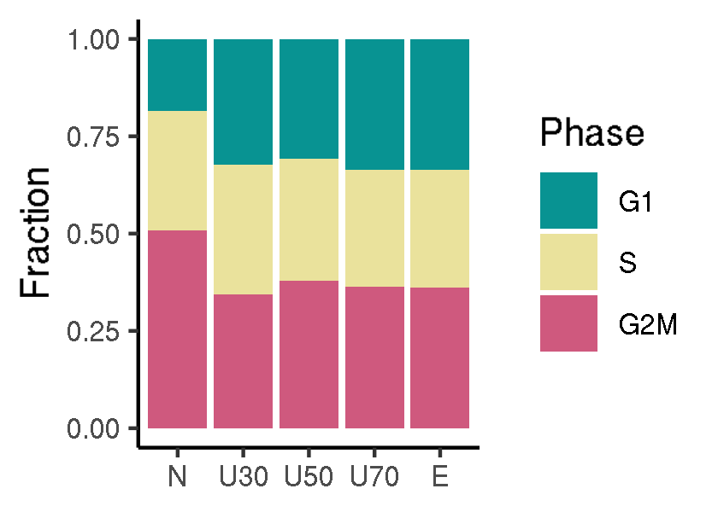
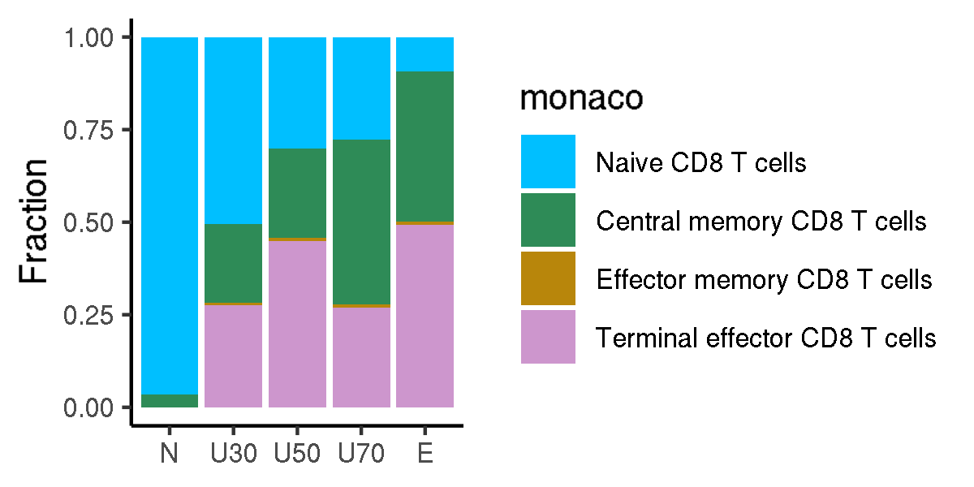
GSE136184: CD8+ T cells across 9 decades of life
UMAPs for cell annotations

Slide 3
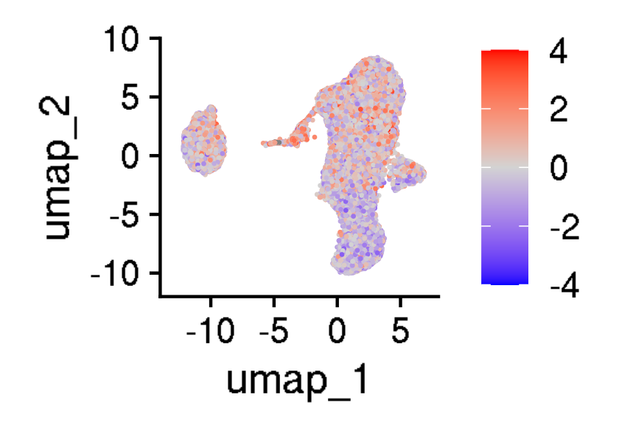



GSE136184: CD8+ T cells across 9 decades of life
UMAPs for cell states

Slide 4
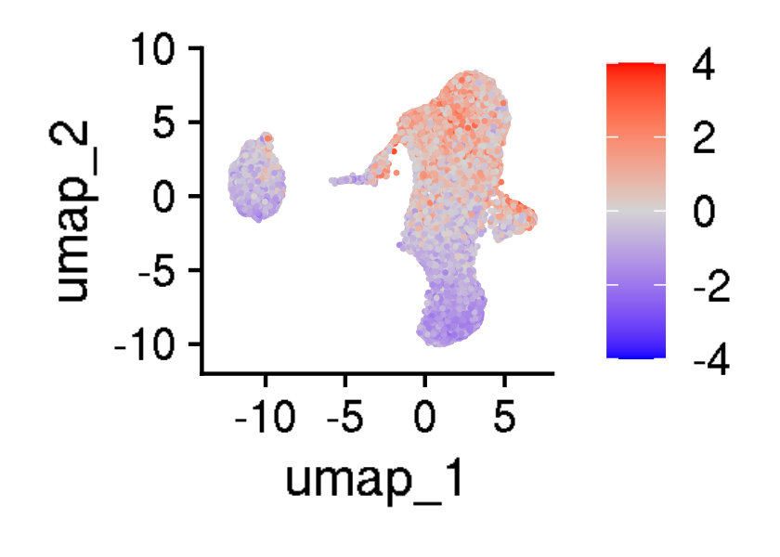
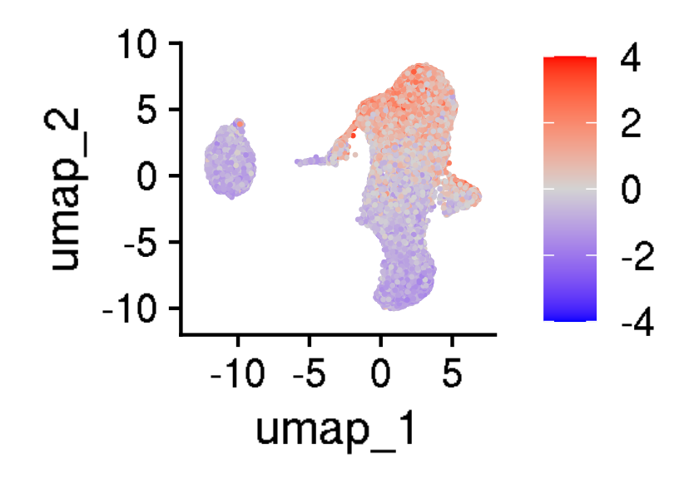
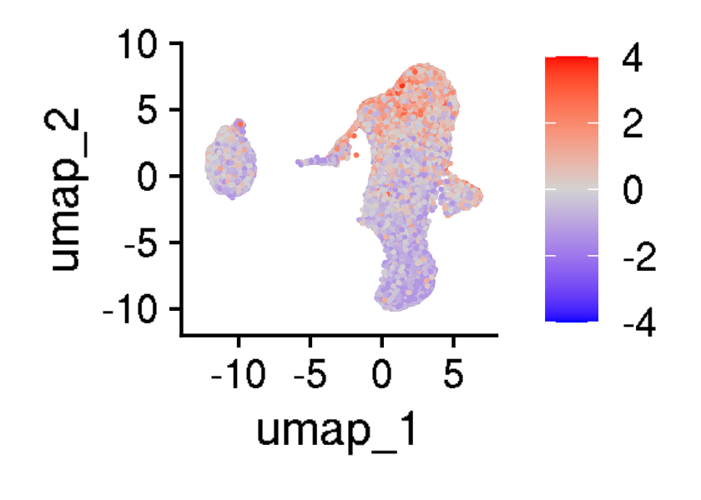

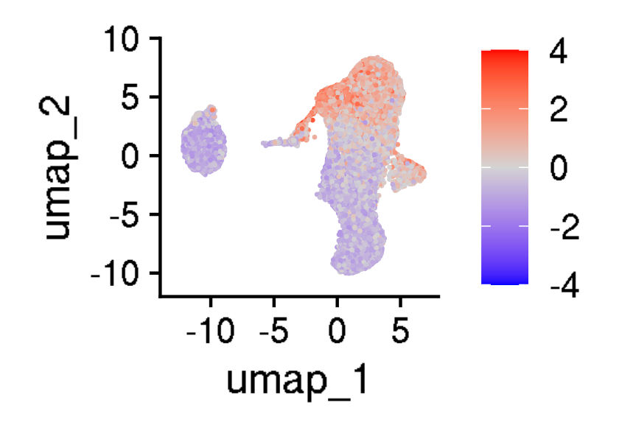
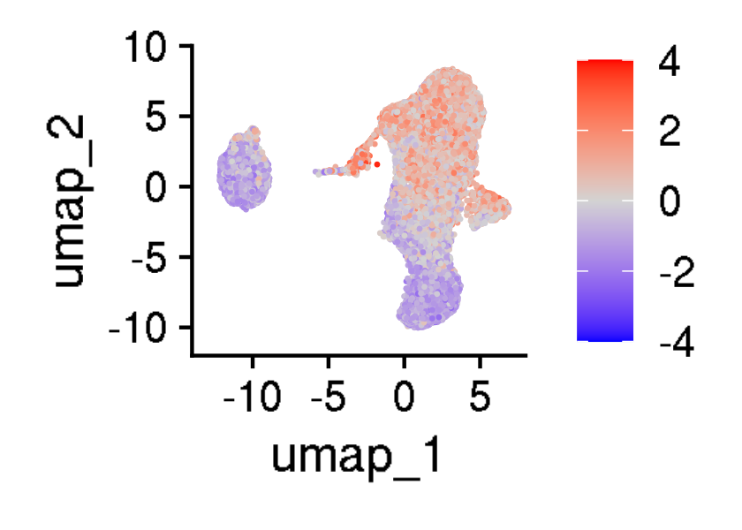

GSE136184: CD8+ T cells across 9 decades of life
UMAPs for exhaustion scores

Slide 5
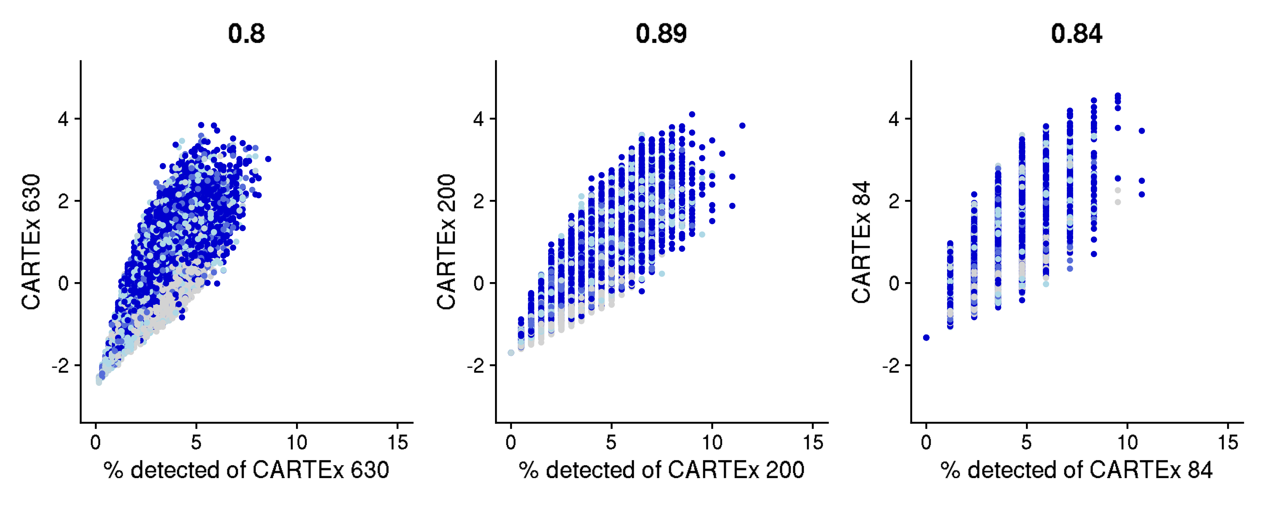
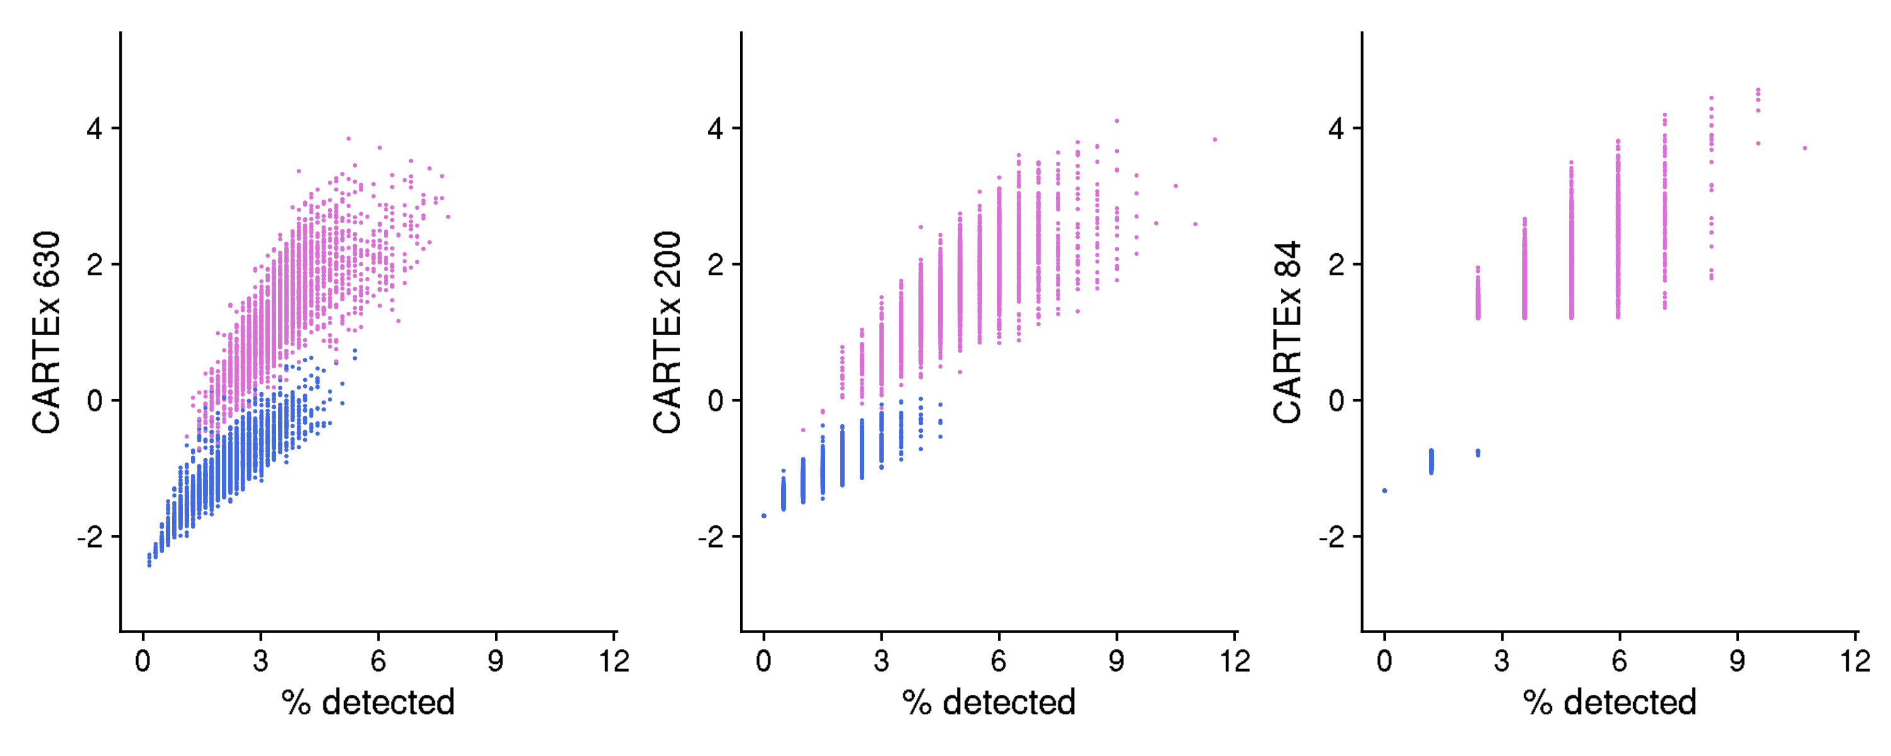
GSE136184: CD8+ T cells across 9 decades of life
Percentage of CARTEx detected

Slide 6
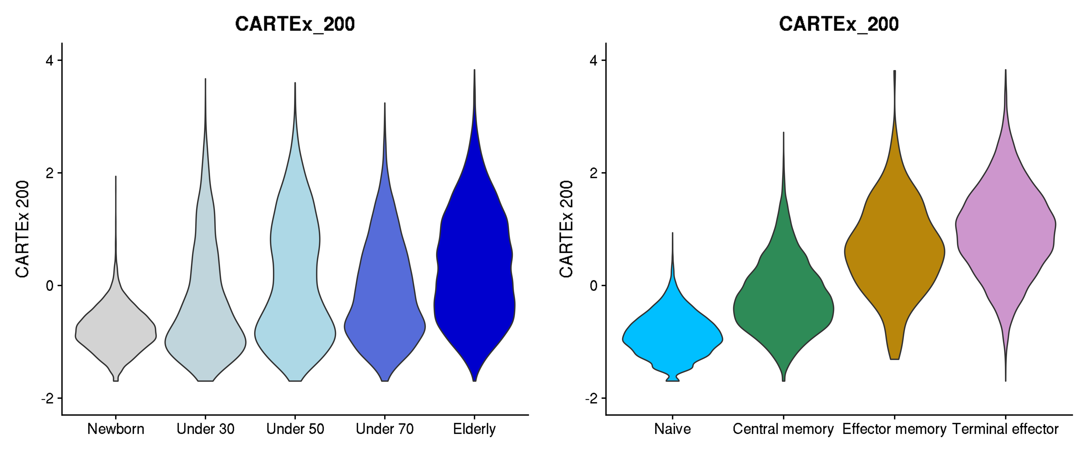
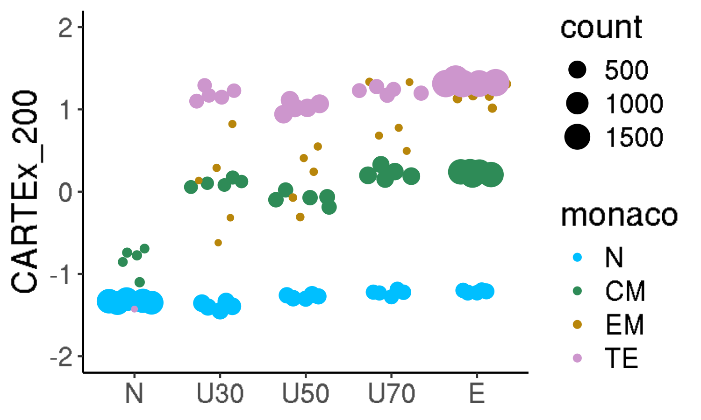
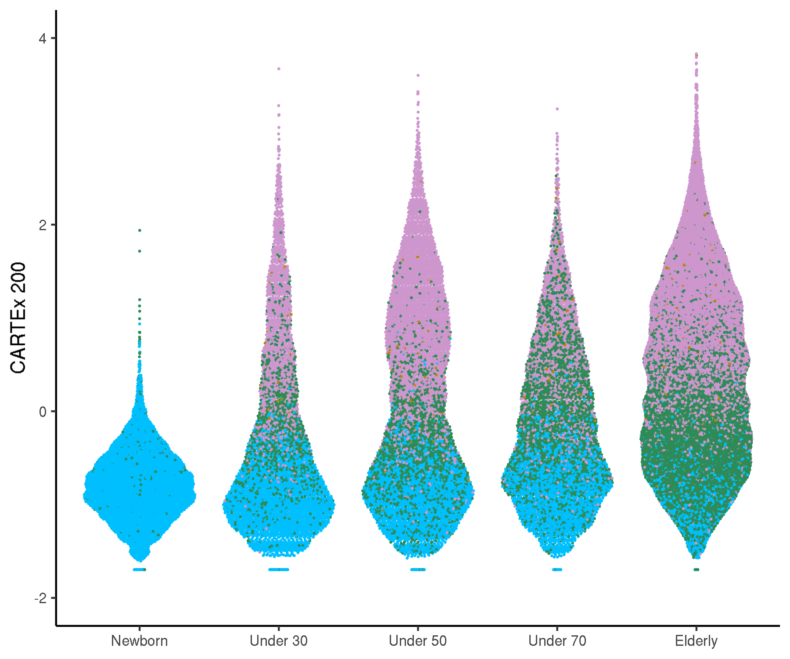
GSE136184: CD8+ T cells across 9 decades of life
Cell type differentiation

Slide 7
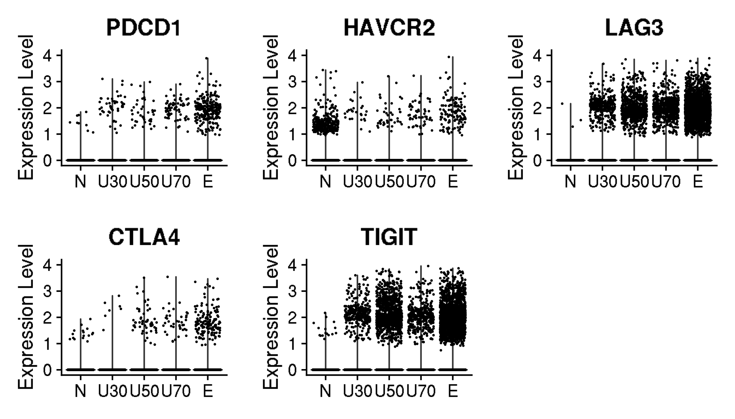
GSE136184: CD8+ T cells across 9 decades of life
Violin plots for canonical exhaustion markers
Gene and corresponding protein
PDCD1 encodes PD-1
HAVCR2 encodes TIM-3
LAG3 encodes LAG-3
CTLA4 encodes CTLA-4
TIGIT encodes TIGIT
ENTPD1 encodes CD39

Slide 8
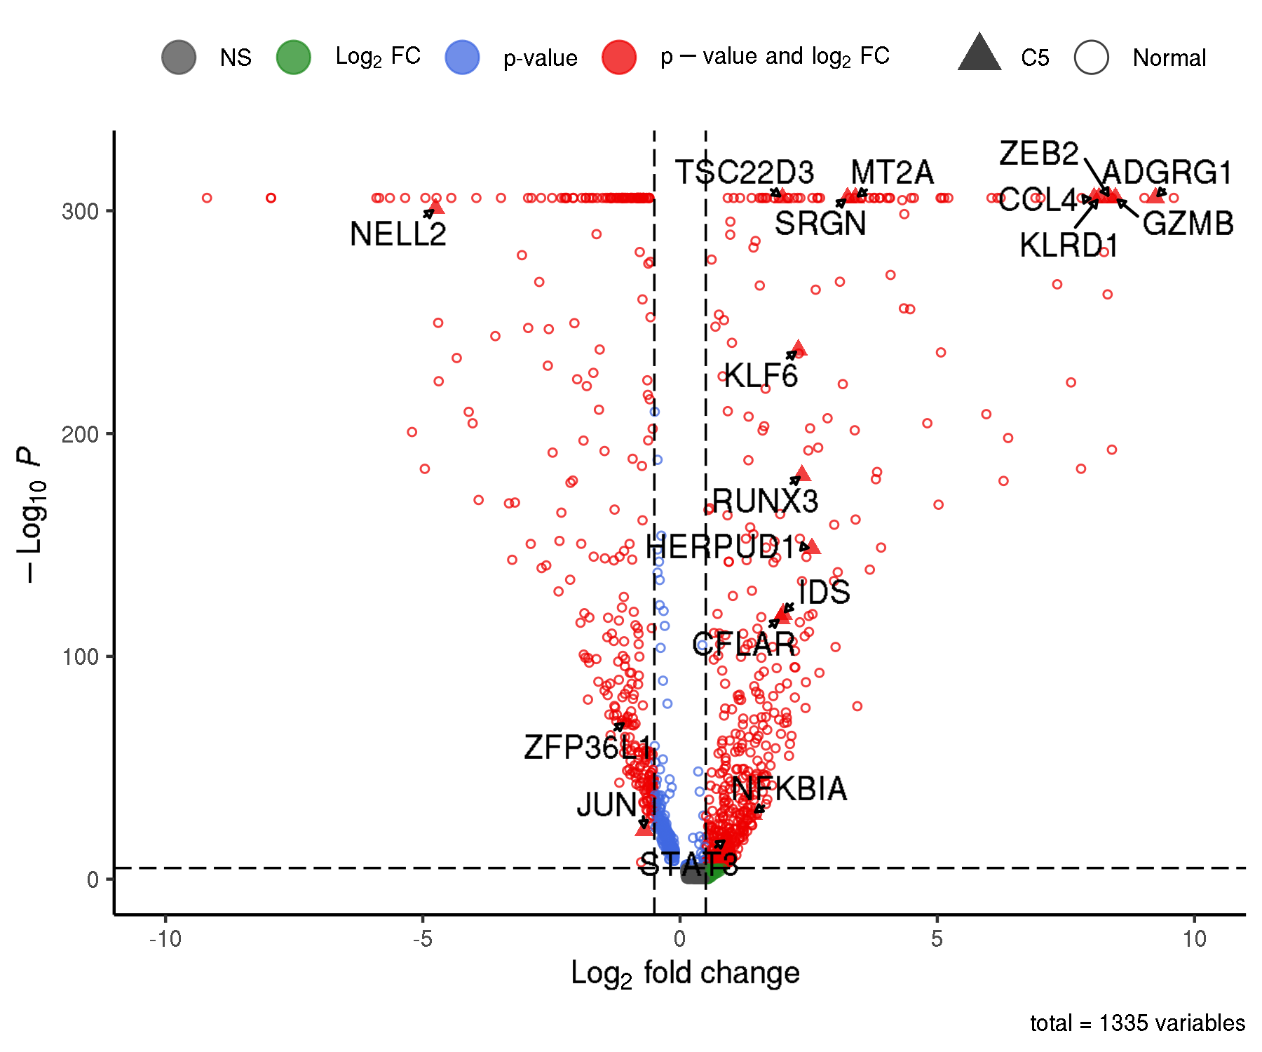
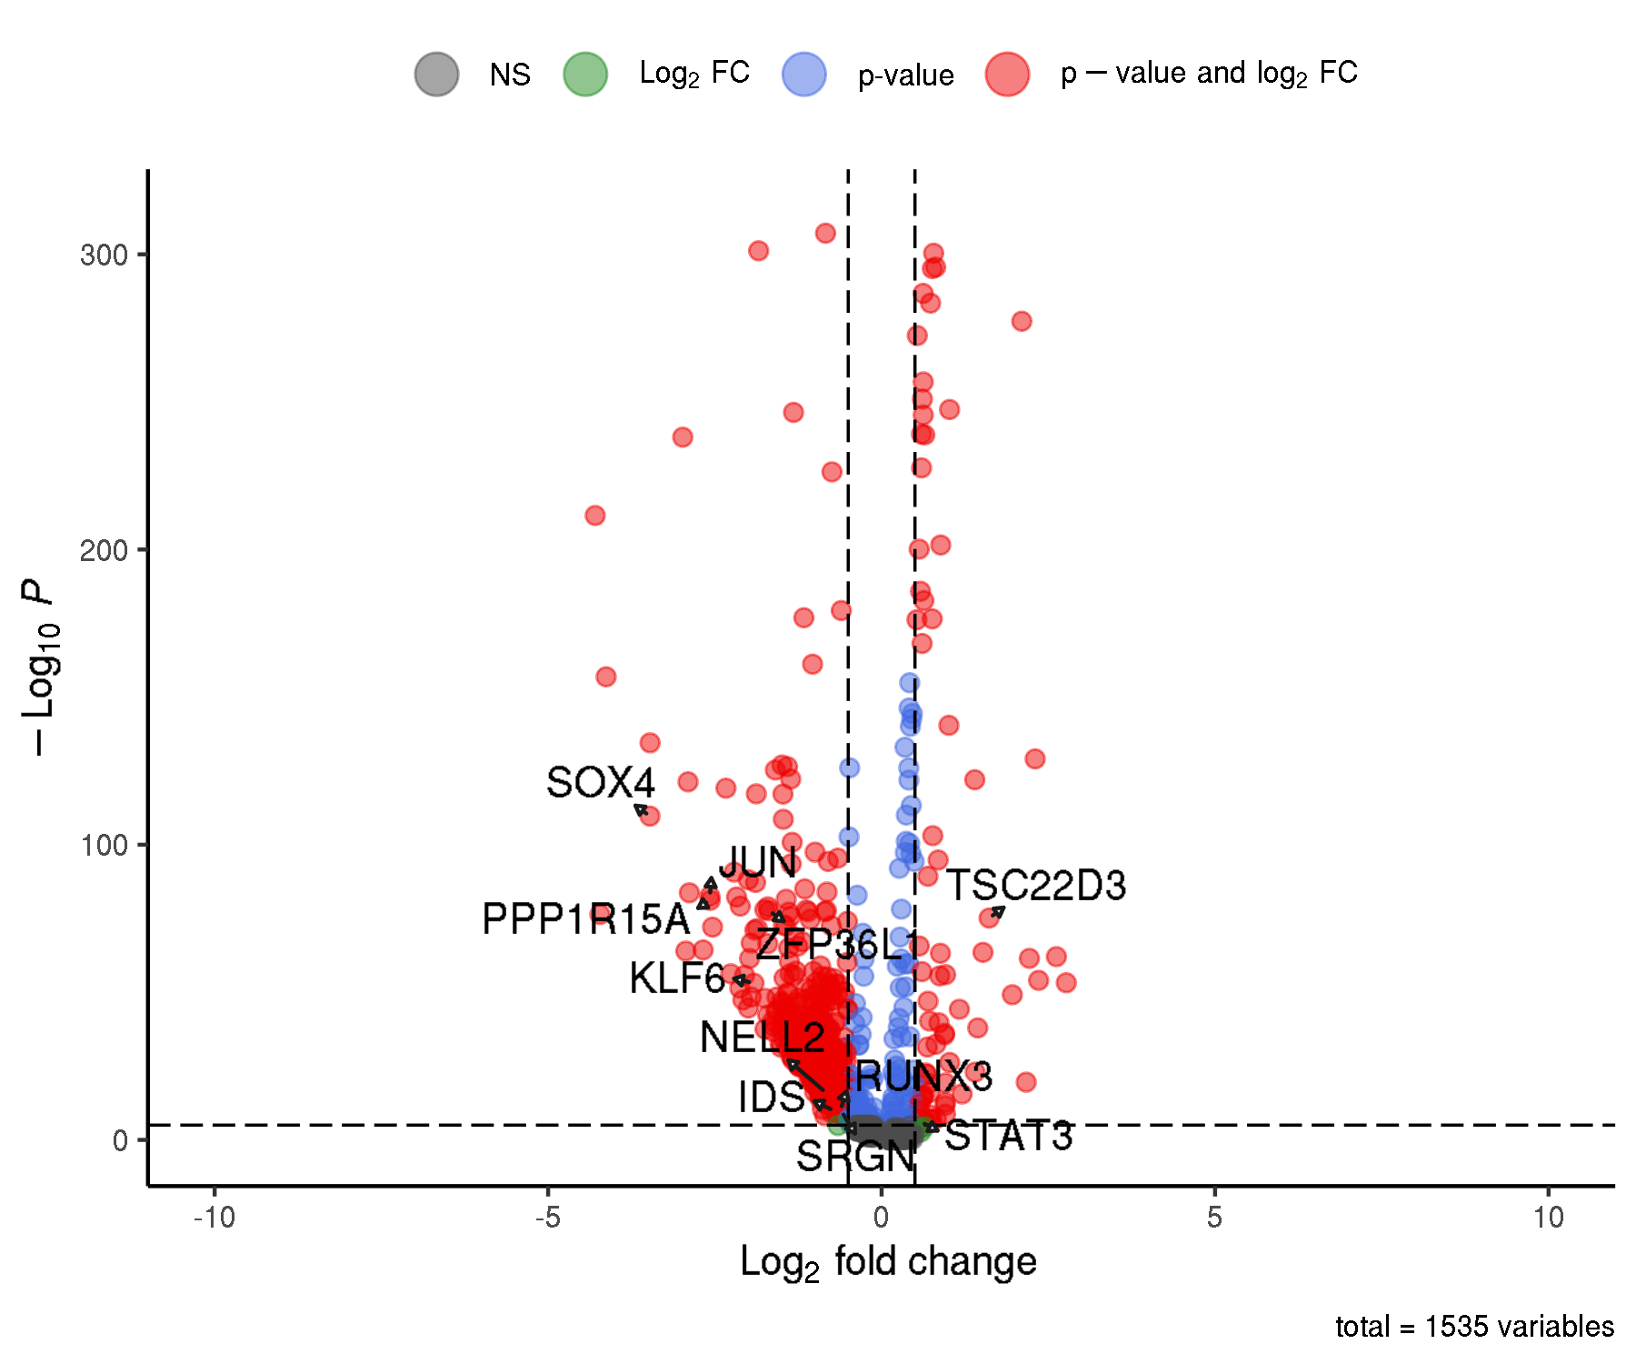
GSE136184: CD8+ T cells across 9 decades of life
Differentially expressed genes

Slide 9
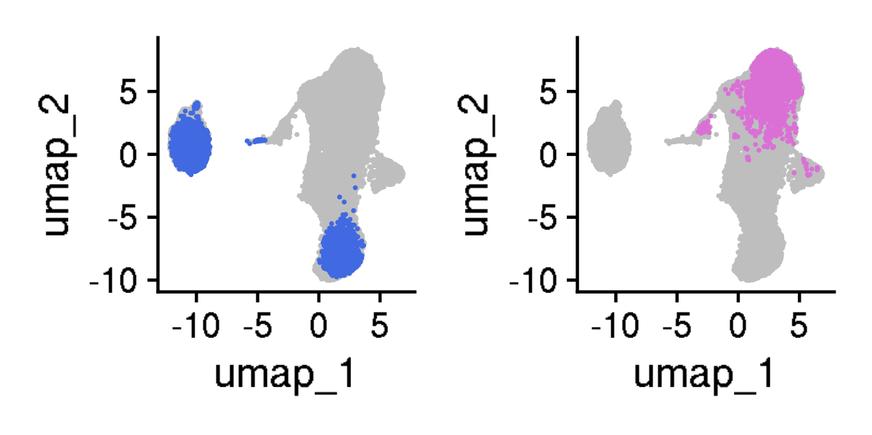
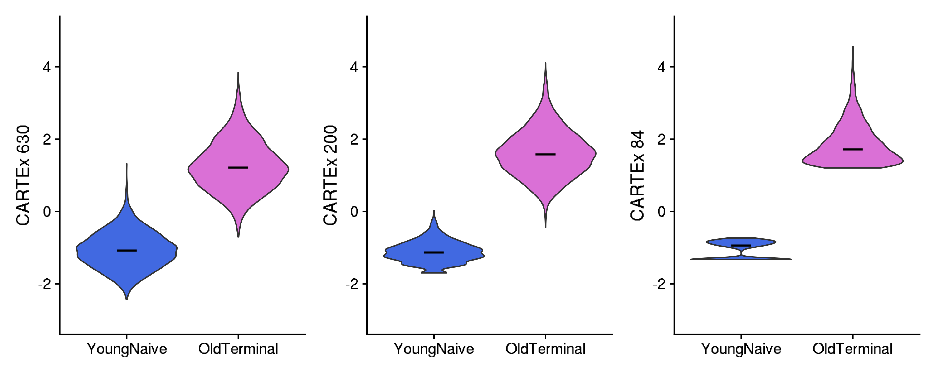
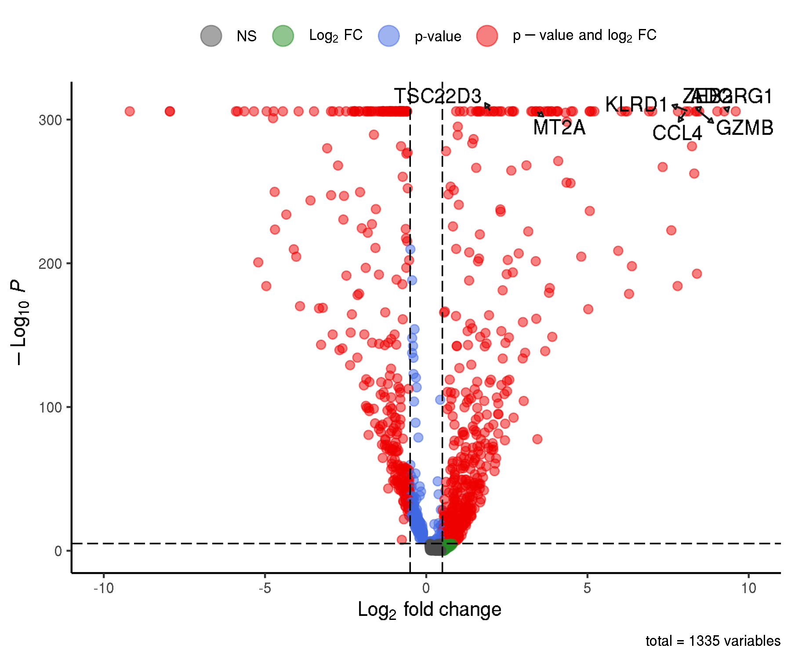
GSE136184: CD8+ T cells across 9 decades of life
Extraction of young naive T cells and old terminal effector T cells

